Slide 1



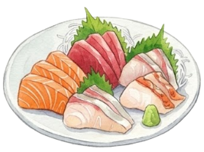
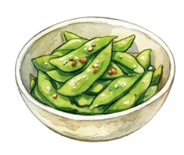
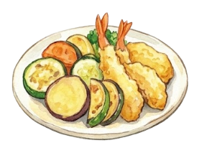
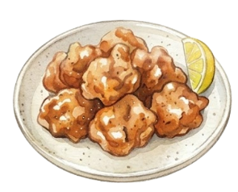


2030 SUMMER FESTIVAL
2030 SUMMER FESTIVAL
2030 SUMMER FESTIVAL
2030 SUMMER FESTIVAL
2030 SUMMER FESTIVAL
2030 SUMMER FESTIVAL
2030 SUMMER FESTIVAL
2030 SUMMER FESTIVAL
2030 SUMMER FESTIVAL
2030 SUMMER FESTIVAL
2030 SUMMER FESTIVAL
2030 SUMMER FESTIVAL
2030 SUMMER FESTIVAL
2030 SUMMER FESTIVAL
2030 SUMMER FESTIVAL
2030 SUMMER FESTIVAL
2030 SUMMER FESTIVAL
SUMMER
2030 SUMMER FESTIVAL
2030 SUMMER FESTIVAL
2030 SUMMER FESTIVAL
2030 SUMMER FESTIVAL
2030 SUMMER FESTIVAL
2030 SUMMER FESTIVAL
2030 SUMMER FESTIVAL
2030 SUMMER FESTIVAL
PARTYPLAN
2030 SUMMER FESTIVAL
2030 SUMMER FESTIVAL
2030 SUMMER FESTIVAL
2030 SUMMER FESTIVAL
2030 SUMMER FESTIVAL
2030 SUMMER FESTIVAL
2030 SUMMER FESTIVAL
2030 SUMMER FESTIVAL
2030 SUMMER FESTIVAL
2030 SUMMER FESTIVAL
2030 SUMMER FESTIVAL
2030 SUMMER FESTIVAL
2030 SUMMER FESTIVAL
2030 SUMMER FESTIVAL
2030 SUMMER FESTIVAL
2030 SUMMER FESTIVAL
2030 SUMMER FESTIVAL
2030 SUMMER FESTIVAL
2030 SUMMER FESTIVAL
2030 SUMMER FESTIVAL
2030 SUMMER FESTIVAL
2030 SUMMER FESTIVAL
2030 SUMMER FESTIVAL
2030 SUMMER FESTIVAL
2030 SUMMER FESTIVAL
2030 SUMMER FESTIVAL
2030 SUMMER FESTIVAL
2030 SUMMER FESTIVAL
2030 SUMMER FESTIVAL
2030 SUMMER FESTIVAL
みんなでカンパイ！
2030 SUMMER FESTIVAL
2030 SUMMER FESTIVAL
2030 SUMMER FESTIVAL
2030 SUMMER FESTIVAL
2030 SUMMER FESTIVAL
2030 SUMMER FESTIVAL
2030 SUMMER FESTIVAL
2030 SUMMER FESTIVAL
2030 SUMMER FESTIVAL
2030 SUMMER FESTIVAL
2030 SUMMER FESTIVAL
2030 SUMMER FESTIVAL
2030 SUMMER FESTIVAL
2030 SUMMER FESTIVAL
2030 SUMMER FESTIVAL
2030 SUMMER FESTIVAL
2030 SUMMER FESTIVAL
2030 SUMMER FESTIVAL
2030 SUMMER FESTIVAL
2030 SUMMER FESTIVAL
2030 SUMMER FESTIVAL
2030 SUMMER FESTIVAL
2030 SUMMER FESTIVAL
2030 SUMMER FESTIVAL
2030 SUMMER FESTIVAL
2030 SUMMER FESTIVAL
2030 SUMMER FESTIVAL
2030 SUMMER FESTIVAL
2030 SUMMER FESTIVAL
2030 SUMMER FESTIVAL
2030 SUMMER FESTIVAL
2030 SUMMER FESTIVAL
2030 SUMMER FESTIVAL
2030 SUMMER FESTIVAL
2030 SUMMER FESTIVAL
2030 SUMMER FESTIVAL
2030 SUMMER FESTIVAL
2030 SUMMER FESTIVAL
ご予算に合わせて料理を提供いたします。
プランは食堂までお問い合わせください！

